Slide 1

Contoso Marketing Principals
Overview

Slide 2
Emotional Connection
Emotional connection is key
The right connection inspires brand loyalty
It’s time to break new ground
Notes:
Emotional connection is key
Research shows that virtually all strong opinions on packaging for our products and those of competitors are emotion-based
The right connection inspires brand loyalty
Change brand perception by getting personal
It’s about the person, not the package
Breaking new ground
Every aspect of the package should have a purpose
We need to get better about making choices

Slide 3

Project team

Slide 4
Project scope
Use Branding for Continuity
Convey Benefits of the New Release
Improve on the Past
Not Just More of the Same
Notes:
Develop packaging design and content for our 2012 product launch that reaches customers effectively in both physical and virtual storefronts.
Implement aspects of our branding for customer recognition and continuity.
Convey the unique benefits of our latest release.
Implement success and failure key takeaways from prior version packaging.
Minimize repetition with packaging from previous releases.

Slide 5


It’s not about the box
The Almighty Box
Which Is the right box?

Slide 6
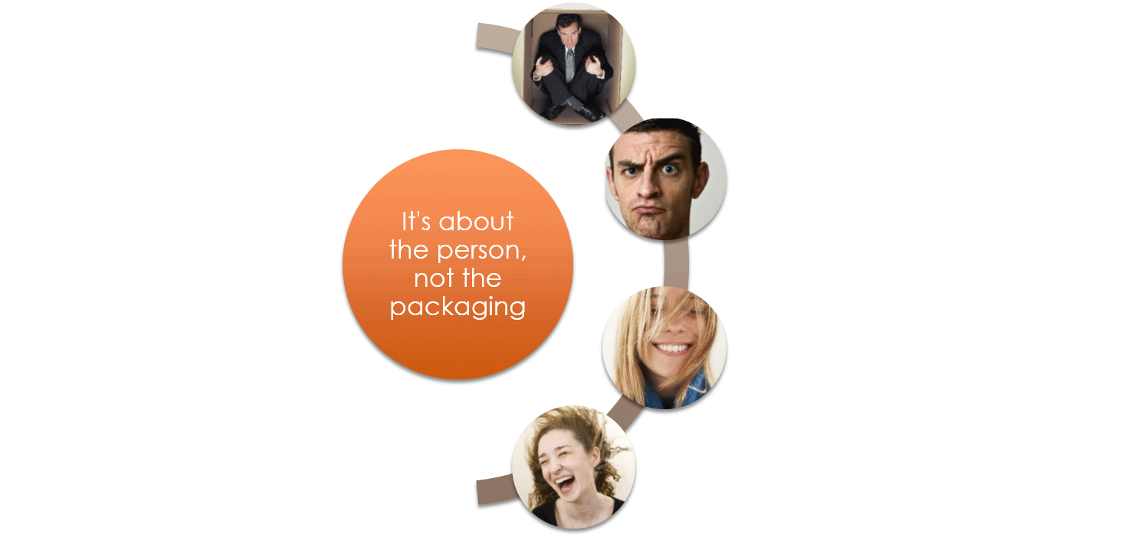
Fit the person—not the Box

Slide 7
Design considerations
What Creates a Connection?
Notes:
What attracts the person to the package?
Shape and color were the clear winners in focus group testing

Slide 8
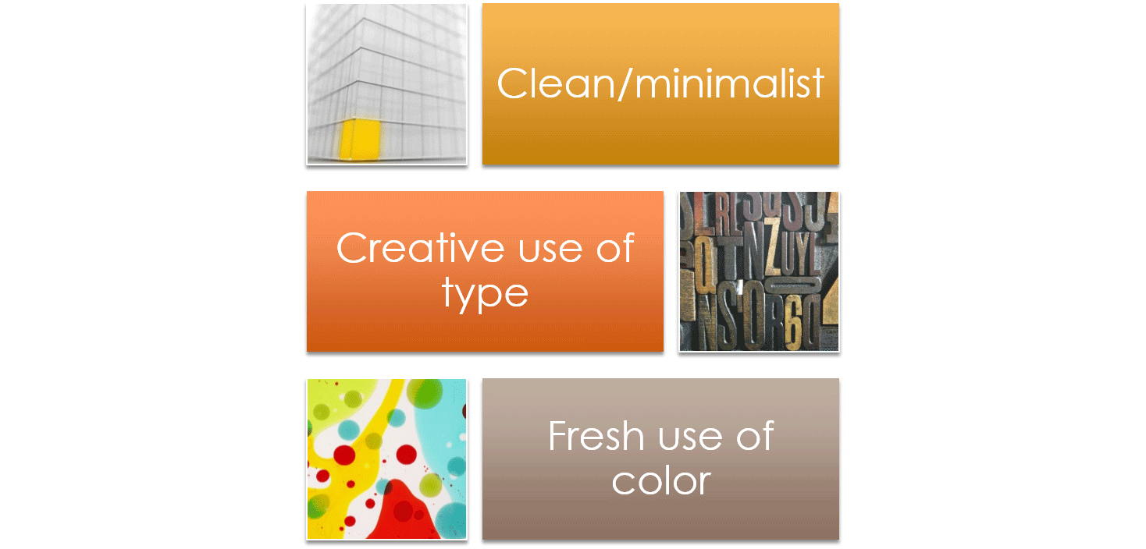
Current trends

Slide 9
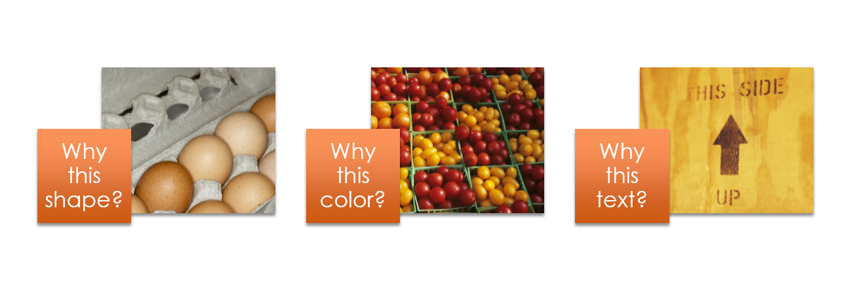
Making Choices
Shape, color, and content are all important
The key is to be selective and make effective choices
Every element must serve a purpose
Notes:
The shape of an egg box protects its content. But it’s also iconic; instantly recognizable for what it is.
Color should be as integral to a product package as the color of a fruit or vegetable. What does the color tell you about what’s inside?
No matter how well written, a package is not like a novel; nobody wants to read it over coffee. Be concise, and be relevant. Every word should serve a purpose.

Slide 10

SO THE BOX HAS TO BE BETTER THAN EVER.
IT’S NOT ABOUT THE BOX.

